Slide 1



Google Solutions Challenge
Team 4
Fatima Zahra
Maryam Ali
Amna Farhath
Nadheera Nisha

Slide 2
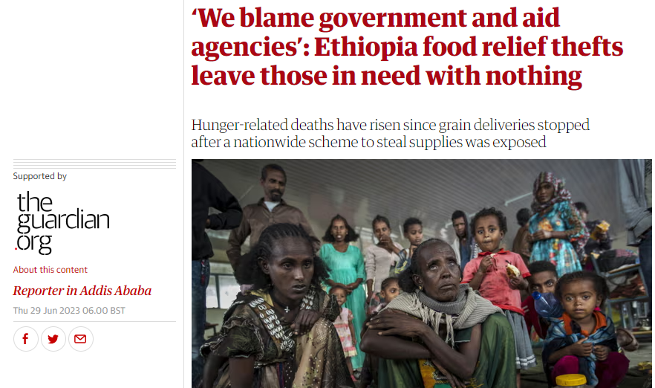

Slide 3


Problem Statement
Funds allocated and aid acquired accordingly
Aid distributed equally through biometric verification
What happens after aid leaves source and before it arrives at destination?
?
Aid Diversion (Theft of Aid!)
Charitable/Humanitarian Organization
Distribution Center

Slide 4

Blockchain
Blockchain is a digital ledger that records transactions across a network of computers.
Once recorded, transactions cannot be altered or deleted, ensuring transparency and security.
Instead of being controlled by a single entity, blockchain is decentralized, meaning data is distributed across multiple computers, enhancing reliability and resilience.

Slide 5
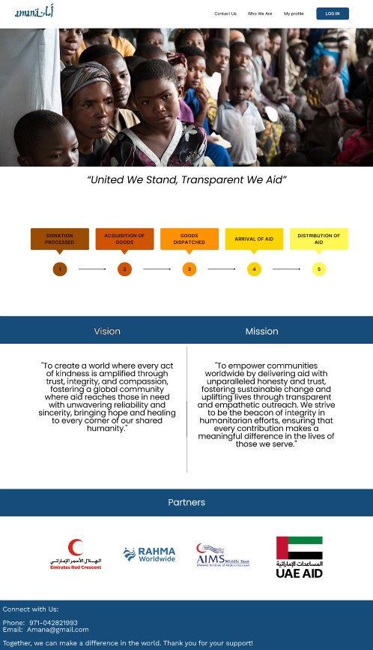
A web-application that facilitates transparent and secure transit of humanitarian aid between humanitarian organizations and aid distribution centers using blockchain, IoT and cloud technologies.

Slide 6





Tech Stack

Slide 7
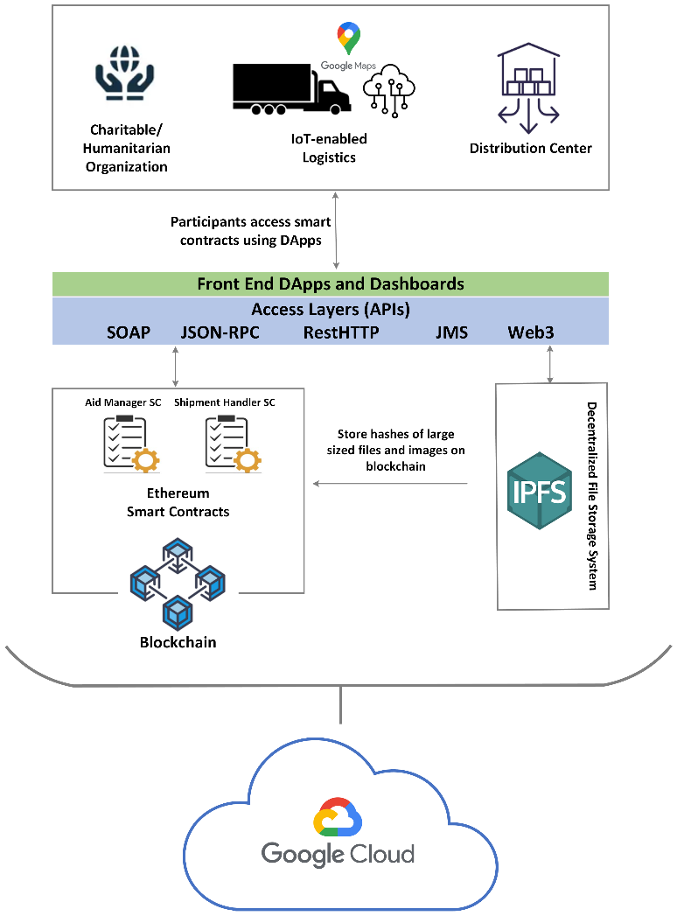
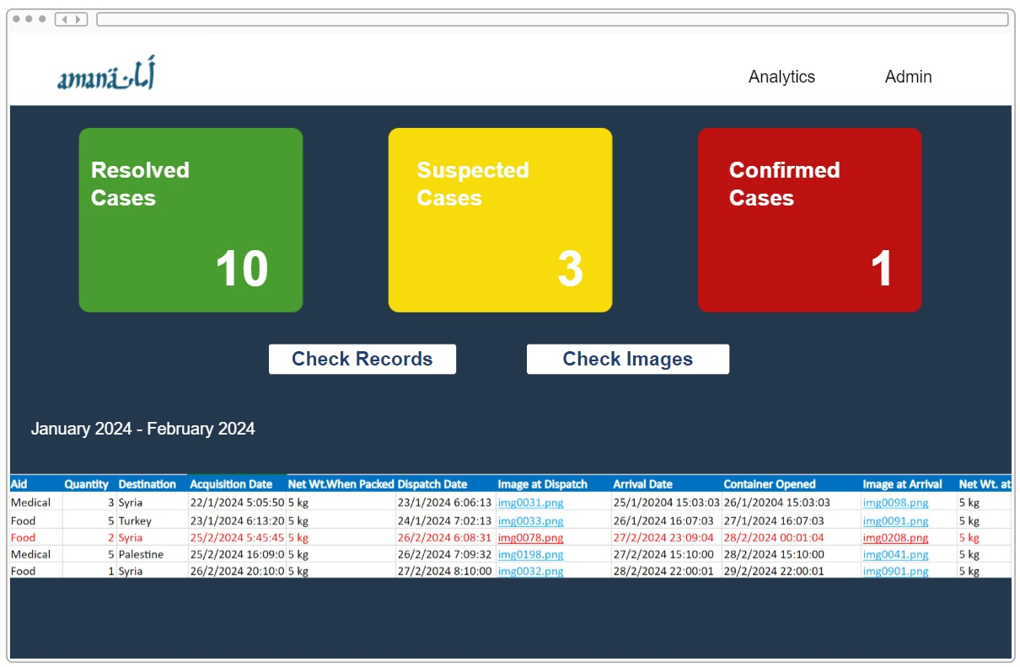
High Level System Architecture
Dynamic Analytics Dashboard for Tracking Incidents
IoT Data Analysis

Slide 8

Detection Methods
Weight – measured at the time of dispatchment and reception
Quantity – barcodes scanned at the time of dispatchment and reception
Images – captured at the time of dispatchment and reception

Slide 9

Detection Method: Weight
Charitable/Humanitarian Organization
Logistics

Slide 10

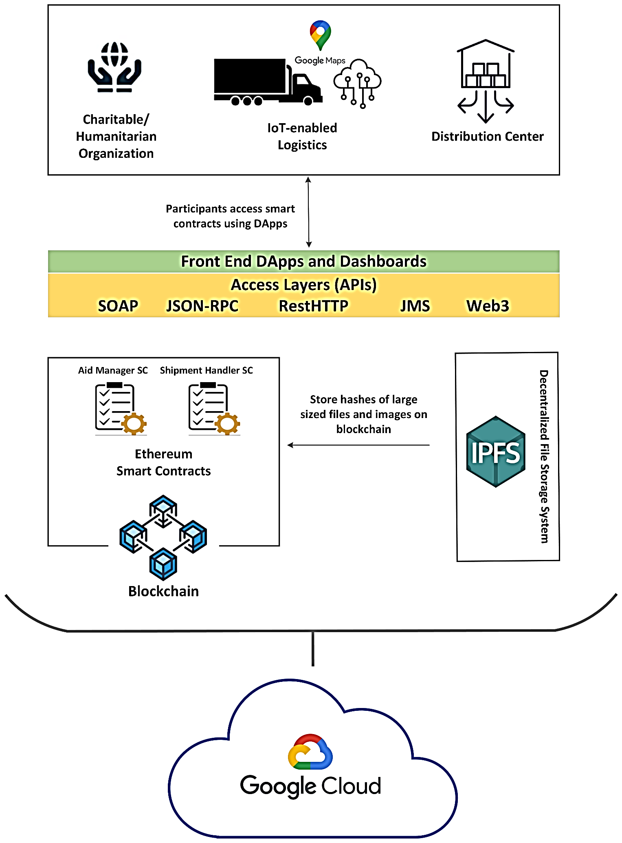

!
IoT/Google Maps Data
Container Opened Before Reaching Destination: Event Triggered

Slide 11
Distribution Center

Slide 12

>
Dispatched
Received
Theft Suspected!
Check Records

Slide 13

Detection Method: Quantity
Quantity Dispatched > Quantity Received
Theft Suspected!

Slide 14

Detection Method: Images
Charitable/Humanitarian Organization
Logistics

Slide 15
Distribution Center
Difference in Images: Fraud Suspected!

Slide 16
Post-Reception Pipeline
IoT data pipelined for analysis

Slide 17

Sustainability Development Goals
Accountability for aid diversion ensures equal and fair distribution of aid, providing sustainable alleviance from poverty, hunger and disease
Prevention of long-term issues and burden on communities resulting from failure to address issues at a smaller scale on time
Leveraging technologies in different ways represents an innovative approach to aid distribution, forming foundation for enhancing industry practices and support for development of sustainable infrastructure for humanitarian operations.
Transparent, accountable and just operations foster a culture of trust amongst institutions for sustainable peace-building efforts and establishment of sustainable and just societies.

Slide 18
Future Improvements
Incentive-based mechanisms
Devising a reward system for those organizations that continue to maintain lowest levels of aid diversion incidents
Token rewards issued on positive outcomes and statistics that can be redeemed for services, good, or further investment opportunities in sustainability development initiatives.

Slide 19
Any Questions? Thank You!

